Slide 1


Slide 2





Leveraging Open-Source Large-Language Model-Enabled Identification of Undiagnosed Patients with Rare Genetic Aortopathies
Pankhuri Singhal*, Zilinghan Li*, Ze Yang*, Tarak Nandi, Zachary Rodriguez, Theodore Drivas, Alexis Rodriguez, Ravi Madduri#, Anurag Verma#
Speaker: Zilinghan Li, Machine Learning Engineer, Argonne

Slide 3
DISCLOSURE OF CONFLICTS OF INTEREST
I have not had any relationships with ACCME-defined ineligible companies within the past 24 months.

Slide 4
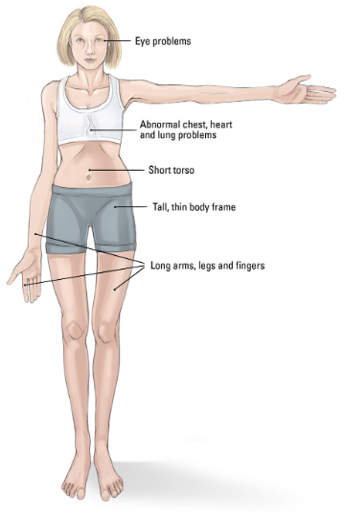
MOTIVATION
Rare genetic syndromes, hereditary aortopathies in particular, are difficult to diagnose due to high phenotypic heterogeneity – not everyone presents the same way.
Example syndromes: Marfan’s, Loeys-Dietz, Turner, etc.
If diagnosis is delayed until symptoms appear, certain damages or complications might become irreversible, reducing treatment effectiveness.
Undiagnosed patients often experience fatal aortic dissection and rupture, which might lead to death.

Slide 5
MOTIVATION
Some rare diseases can be detected earlier if genetic testing is done, enabling early proactive interventions.
However, many physicians receive minimal training to refer genetic testing for patients.

Slide 6
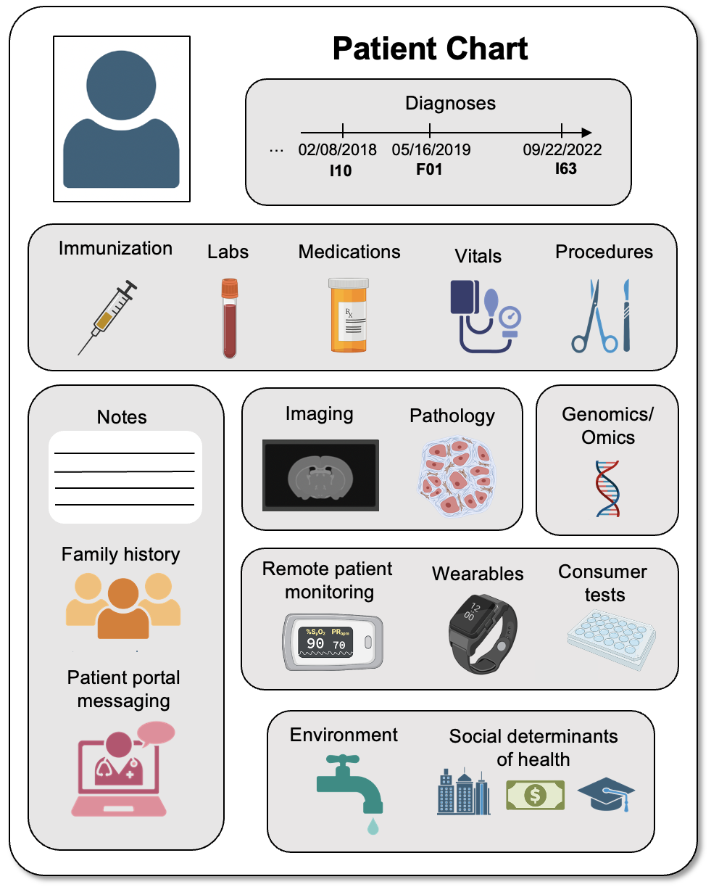
PROBLEM DESCRIPTION
Free-text clinical notes contain observations and narratives regarding a patient's health history that can serve as evidence to support recommendations for genetic testing.
Nowadays, Large Language Models (LLMs) have become very powerful at knowledge distillation and understanding.
Goal: Can LLMs help identify undiagnosed patients in an early screening stage by recommending patients for genetic testing? And finally make it an impactful end-to-end pipeline integrated into clinical settings?

Slide 7
PIPELINES
Prediction
LLM
Genetic Test: Y/N?
Llama
3.1 8B
Instruct
Patient Note
② Inference
① Prompting
Reasoning
③ Evaluation
We want to provide the model with more information to give a more confident (and hopefully more accurate) prediction …
Prediction Confidence
low conf.
?
Compute confidence
from log probs
high conf.
By using Retrieval Augmented Generation (RAG) to provide more relevant information to the model
④ Recommendation
Rare Disease AI-Recommendation Pipeline
* We chose Llama3.1 8B as it is open-source, portable, supports long-context window (up to 128k tokens), and provides great performance in our initial testing.

Slide 8
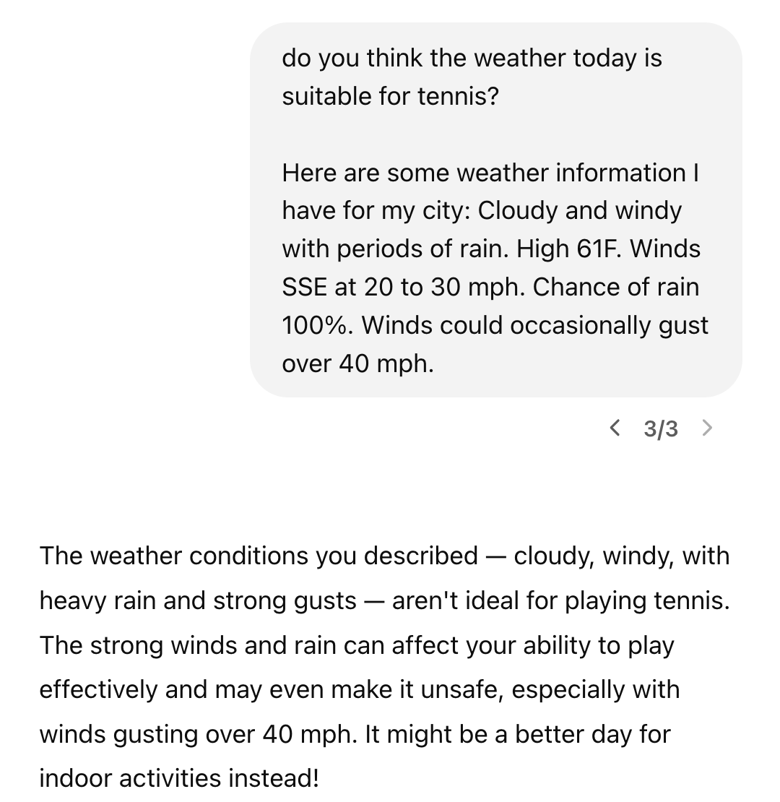
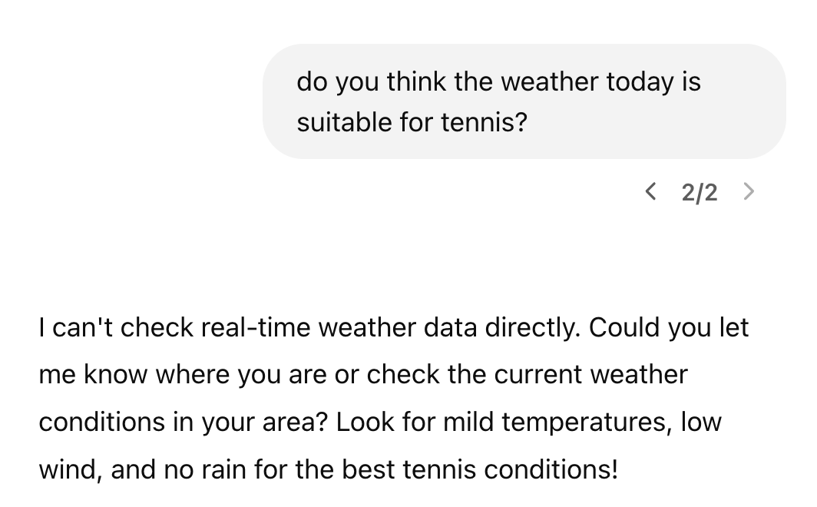
QUICK SIDE NOTE
What is Retrieval Augmented Generation (RAG)?
Retrieve relevant information from external database to Augment the user prompt to assist the Generation
No RAG
With RAG

Slide 9
PIPELINES
(External) Database Creation
For example:
Corpus
Chunking
Retriever
Marfan syndrome (MIM 154700) is a panethnic, autosomal dominant, connective tissue disorder that results from mutations in the fibrillin 1 gene (FBN1, MIM 134797). This syndrome has an incidence of approximately 1 in 5000. Approximately $25\%$ to $35\%$ of patients have de novo mutations. Mutations leading to Marfan syndrome are scattered across the gene, and each mutation is usually unique to a family…
Aortopathy literature and textbooks
MinerU Extraction
BM25
Curation
Indexing
Semantic Chunking
MedCPT
Gene Reviews
A “dictionary” that can be queried for relevant text chunks.
Notes:
Any examples???

Slide 10
Retriever
Contextual Splitting
PIPELINES
BM25
Sliding Window Splitting
④
MedCPT
④ Retrieval
LLM
④
Prediction
Context
Genetic Test: Y/N?
Llama
3.1 8B
Instruct
⑥ Re-Inference
⑤ Re-Prompting with Context
Patient Note
Reasoning
② Inference
① Prompting
to step ④
⑦ Recommendation
③ Evaluation
Prediction Confidence
Pipeline Output
low conf.
Patient-Level Recomme-
-ndations
Note-Level Recomme-
-ndations
Compute confidence
from log probs
⑧ Consensus-
based Evaluation
high conf.
④ Recommendation
Rare Disease AI-Recommendation Pipeline

Slide 11
PIPELINES - SUMMARY
Pipeline Steps:
Leverage open-source base LLM to make recommendations per note
Confidence check based on output probability to identify low-confidence recommendations
Leverage RAG on aortopathy literature to make recommendations on low-confidence notes
Evaluation across all notes of each individual patient to generate final patient-level recommendation
The pipeline is reusable – it can be reconfigured and repurposed for any disease area.

Slide 12
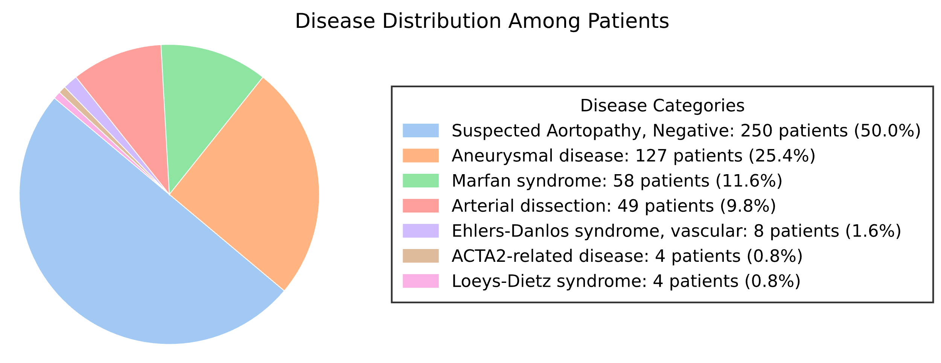
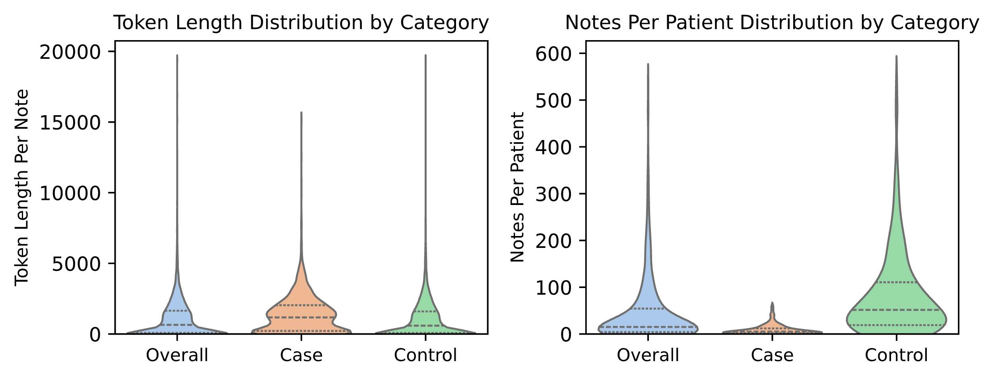
EXPERIMENTS - SETTINGS
Data: Real patient notes from Penn Medicine Bio Bank
250 cases (individuals referred for genetic testing), 250 controls (no genetic diagnoses, never referred for genetic testing)
All progress notes from last 5 years – 20,720 notes
A
B
C

Slide 13
EXPERIMENTS - SETTINGS
Domain specific knowledge corpus: disease-specific clinical guidelines, textbooks, and literature (open-source) – corpus integrated using retrieval augmentation generation
Model: tested many open-source models such as llama2, llama3, llama3.1, mistral, etc. and we finally decide to go with llama3.1-8B-Instruct
Compute Environment: The pipeline is running on a secure environment approved by Penn Medicine on Databricks.

Slide 14
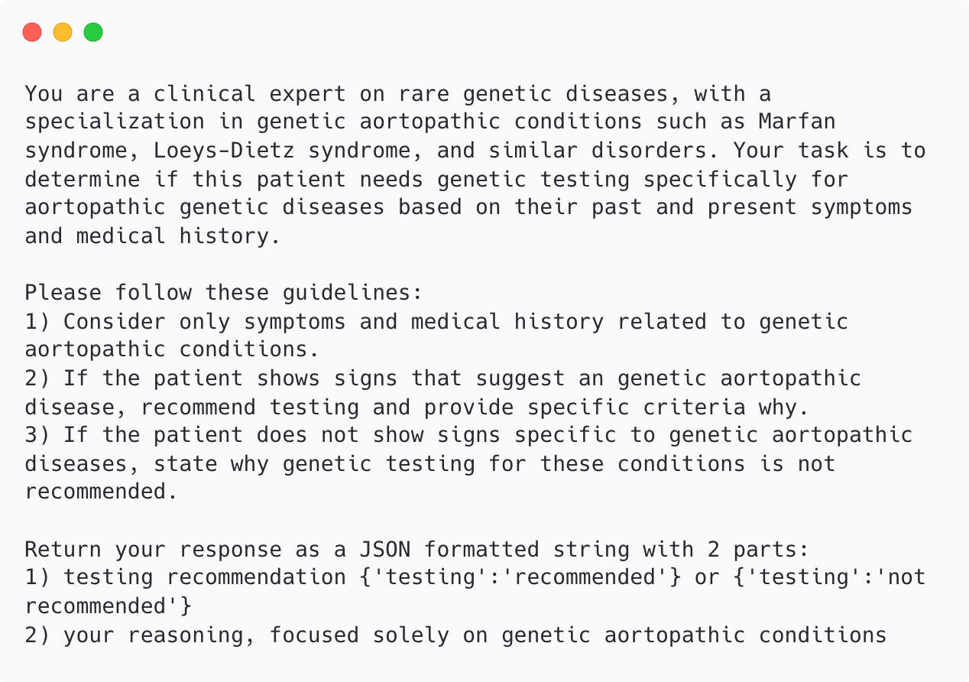
EXPERIMENTS - PROMPT
Prompt is important! It guides the model’s response by setting the context, scope, and intent of the output.
A well-crafted prompt is the key to improving the usefulness and accuracy of an LLM’s output.

Slide 15
EXPERIMENTS - PROMPT
EXPERIMENTS - PROMPT
General guidelines: role description, and the overall expectations.
Medical guidelines
Return format specification – in json-formatted string for easy parsing.

Slide 16
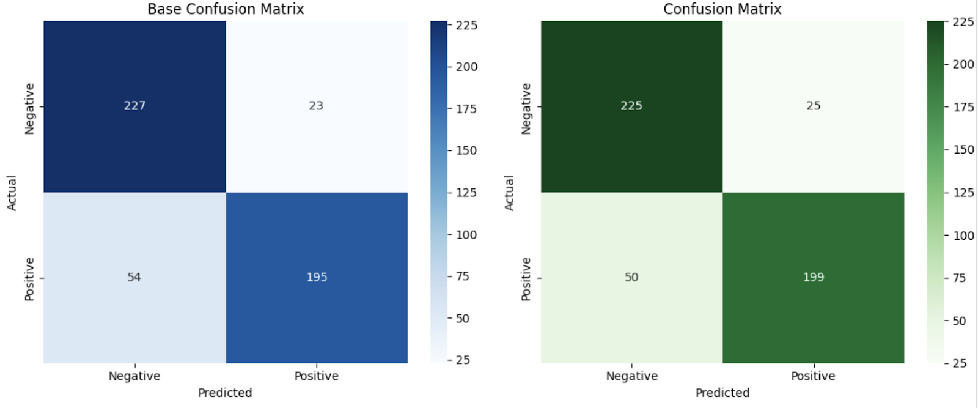
EXPERIMENTS – MAIN RESULTS
Base Accuracy: 0.8457
Base Precision: 0.8945
Base Recall: 0.7831
Base F1 Score: 0.8351
Base F3 Score: 0.7930
Final Accuracy: 0.8497
Final Precision: 0.8884
Final Recall: 0.7992
Final F1 Score: 0.8414
Final F3 Score: 0.8073
Accuracy: +0.47%
Precision: -0.68%
Recall: +2.05%
F1 Score: +0.76%
F3 Score: +1.80%
Pipeline Results without Re-run on
Low Confidence Notes
Pipeline Results with Re-run on Low Confidence Notes

Slide 17

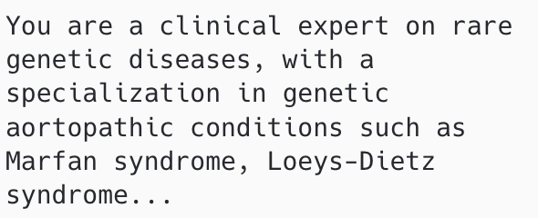
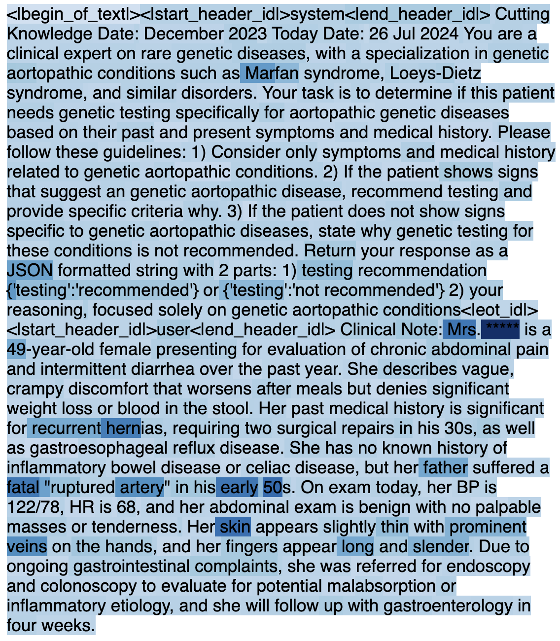
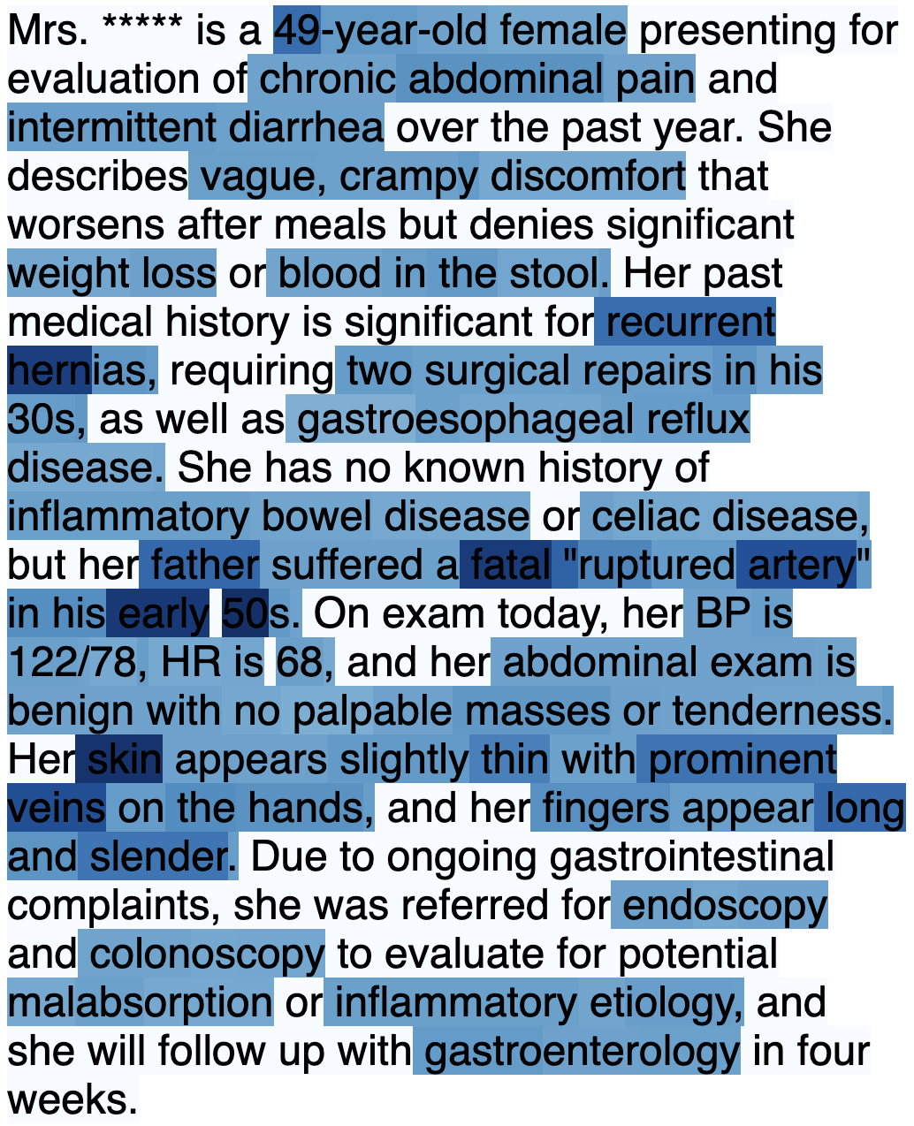
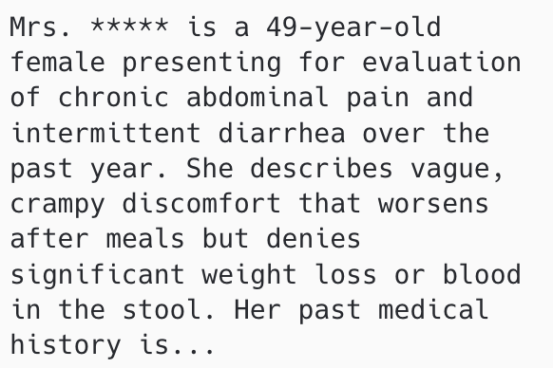
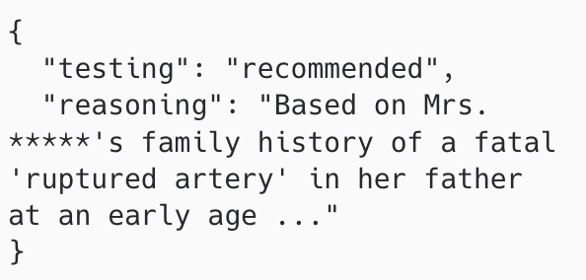
EXPERIMENTS - INTERPRETABILITY
We built a model interpretability pipeline to ensure recommendations are grounded in meaningful clinical evidence – we show how LLM “pays attention to” different input parts to generate its output.
LLM Inputs
Model Interpretability
Filter
System Prompt
(1) Filter out system prompt
Perturbation-based Attribution
(2) Keep only medical related terms
* The note used in this example is synthetic to avoid leaking any patient privacy.
Clinical Note
LLM Generations
Input Attributions
Final Attributions
Kokhlikyan, Narine, Vivek Miglani, Miguel Martin, Edward Wang, Bilal Alsallakh, Jonathan Reynolds, Alexander Melnikov et al. "Captum: A unified and generic model interpretability library for pytorch." arXiv preprint arXiv:2009.07896 (2020)

Slide 18
CONCLUSION AND FUTURE WORK
An end-to-end LLM-based genetic test recommendation pipeline.
Pipeline is scalable, portable, and generalizable, enabling easy adaptation to other disease prediction and early screening tasks.
While Llama-3.1-8B-Instruct demonstrates feasibility, ongoing advances in open-source and proprietary LLMs promise further accuracy improvements.
Future work involves integration with EHR systems to maximize clinical impact.

Slide 19
Thank you!
Q & A

